Slide 1

Bird Species Identification e-Science Application Case in Qinghai Lake Region
PRAGMA 28, Nara, Apr.8-11, 2015
Li Jian(lijian@cnic.cn); Yan Baoping (ybp@cnci.cn)
Computer Network Information Center, CAS
April 10, 2015

Slide 2
Outline
Introduction
Data collection and database system
Bird Species identification
Future work

Slide 3
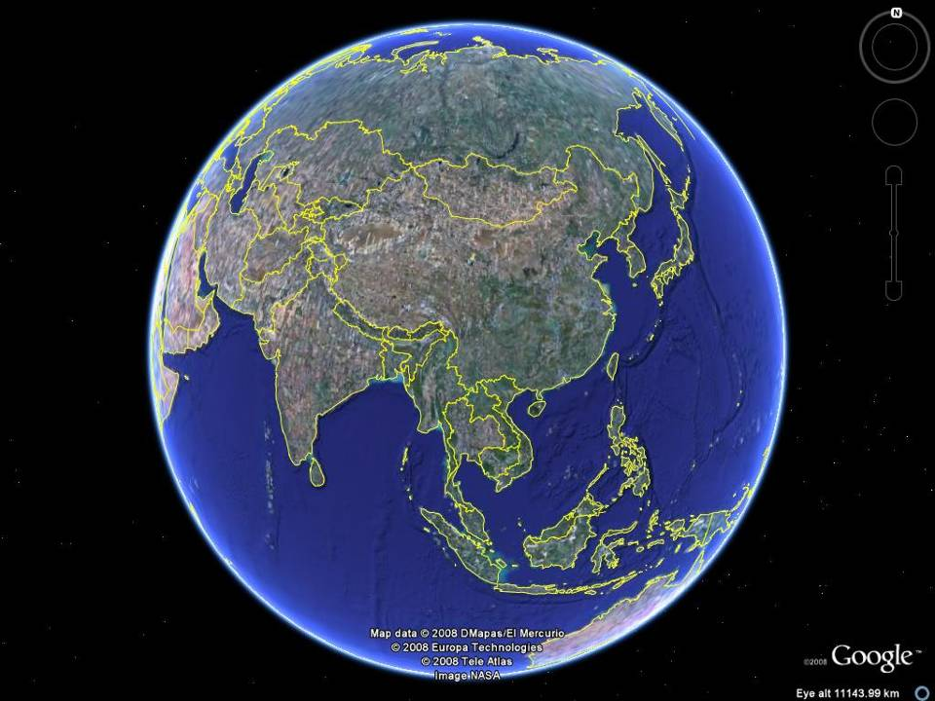
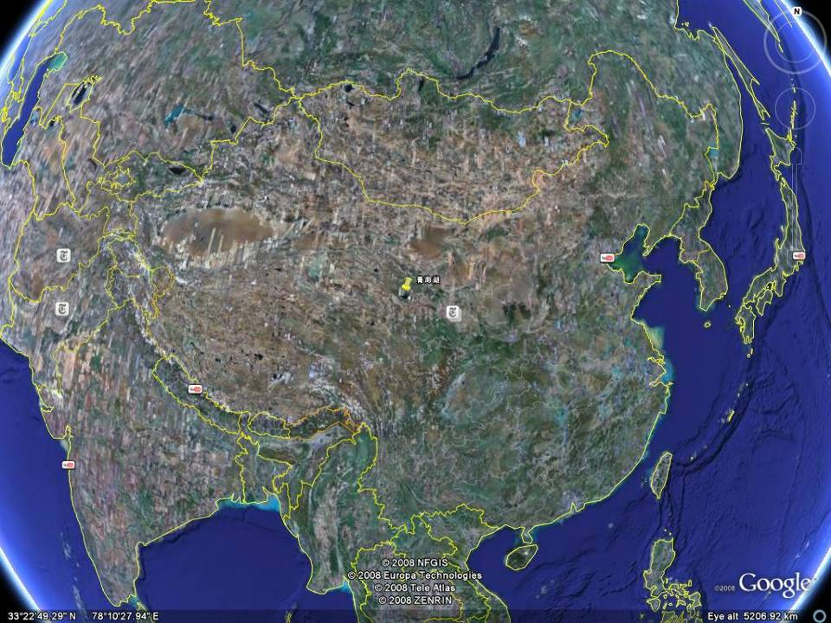
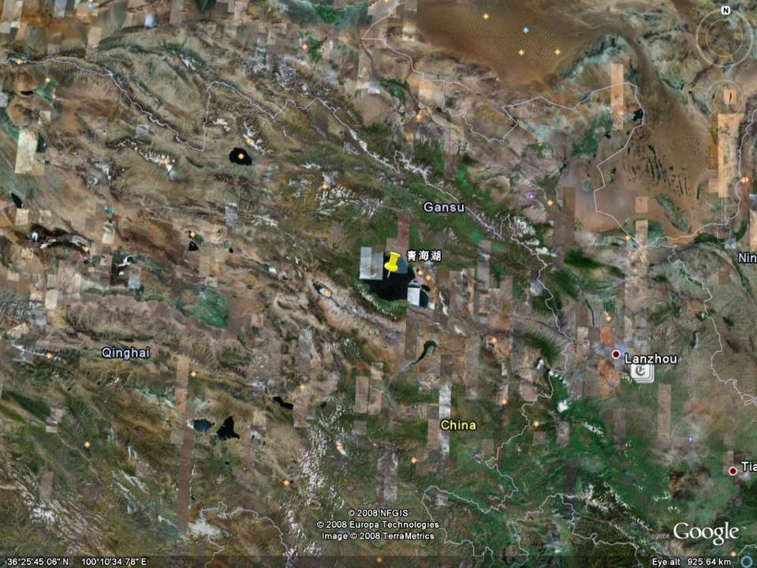
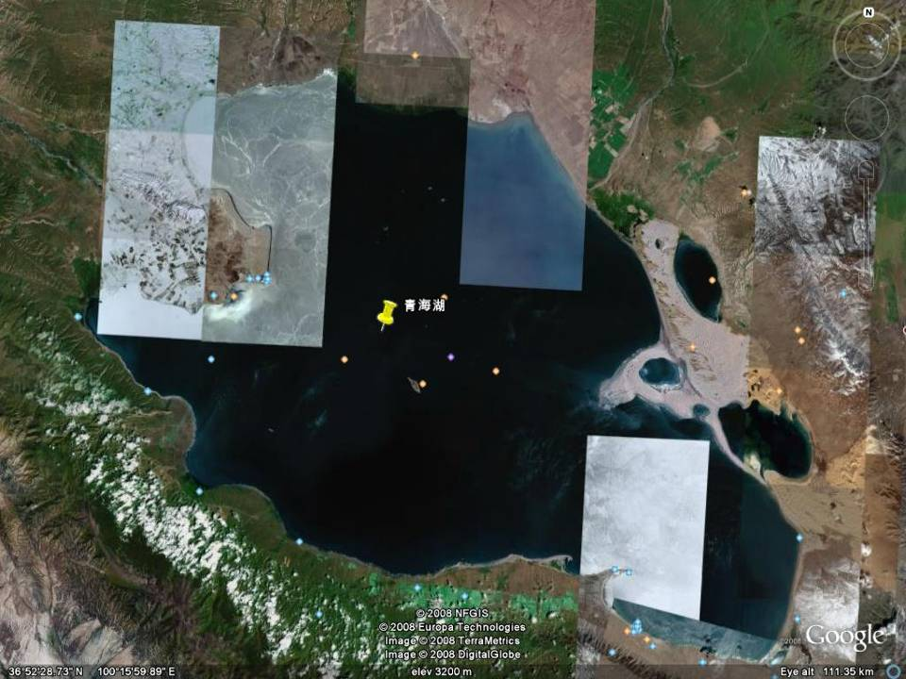
Qinghai Lake is located at the north-eastern end of the Qinghai-Tibetan Plateau

Slide 4

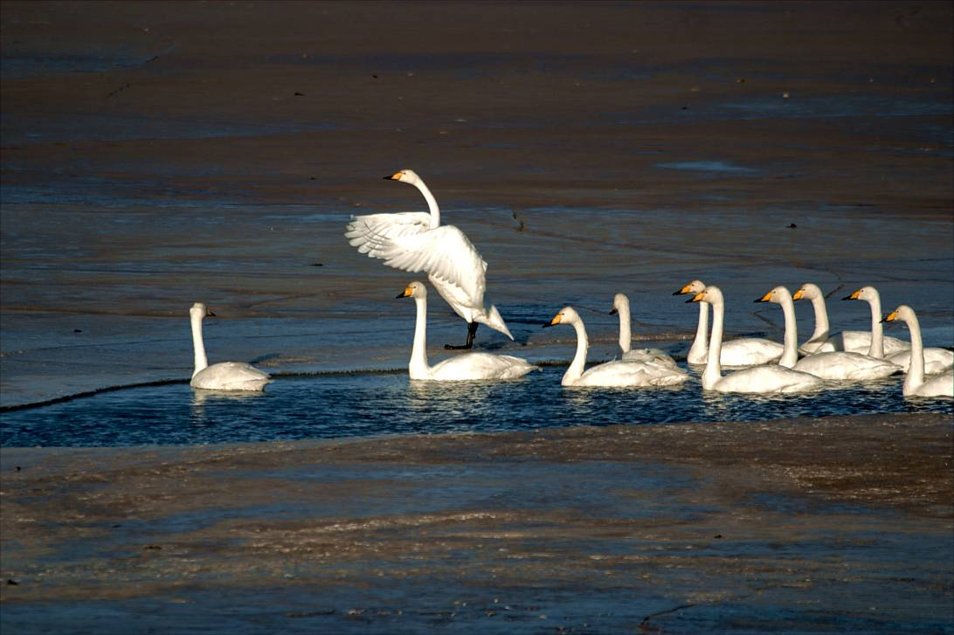
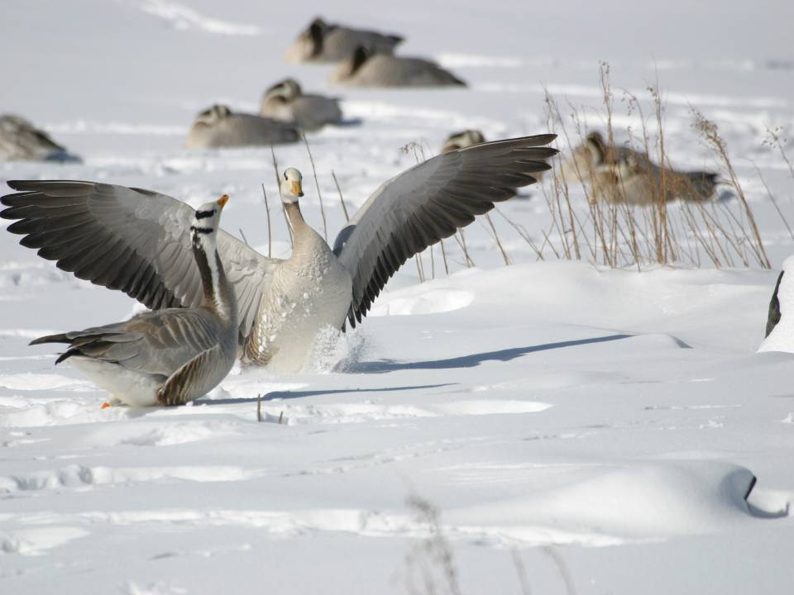
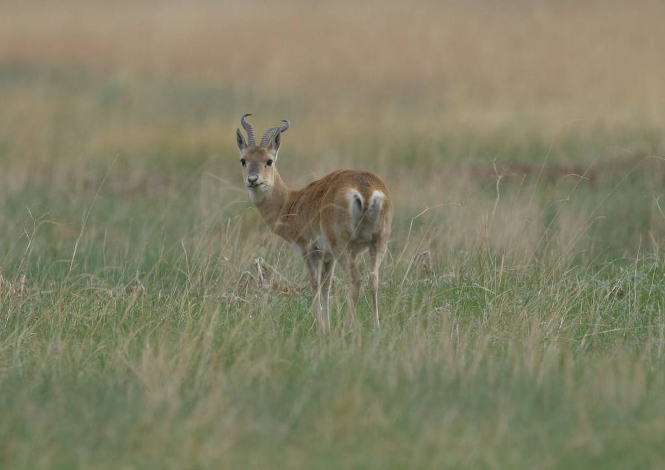
rich in plants and aquatic biological resources
a paradise for birds living and breeding
the largest inland saline lake in China
wetland of International Importance
Przewalski's Gazelle
Endangered Species, just live in China, total number less than 500 in the world

Slide 5
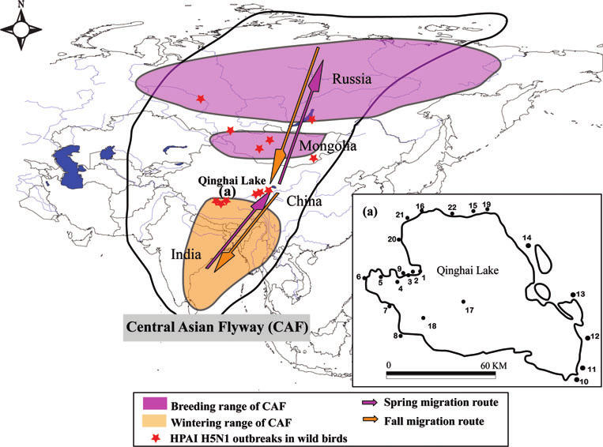
Qinghai Lake is one of the most important breeding and stopover sites for migratory birds along the Central Asian Flyway
Location map of Qinghai Lake, including the range of the Central Asian Flyway.

Slide 6








e-Science Application in Qinghai Lake Region
the first e-Science application for supporting ecological protection and research in plateau region, as well as the first application to national nature reserve in China
Joint Research Center of Chinese Academy of Sciences and Qinghai Lake National Nature Reserve
Notes:
Computer network information center
Institute of microbiology
Institute of zoology
Wuhan Institute of virology
Institute of Remote sensing applications
Cold and Arid Regions Environment and Engineering Research Institute

Slide 7
Outline
Introduction
Data collection and database system
Bird Species identification
Future work

Slide 8
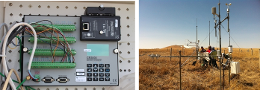
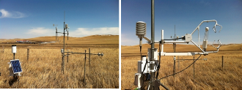
Network Infrastructure
IPv6 enabled network system
Connects the networked observing systems deployed in the core protection area of the QLNNR into CSTNET
A component of China Next Generation Network (CNGI)

Slide 9
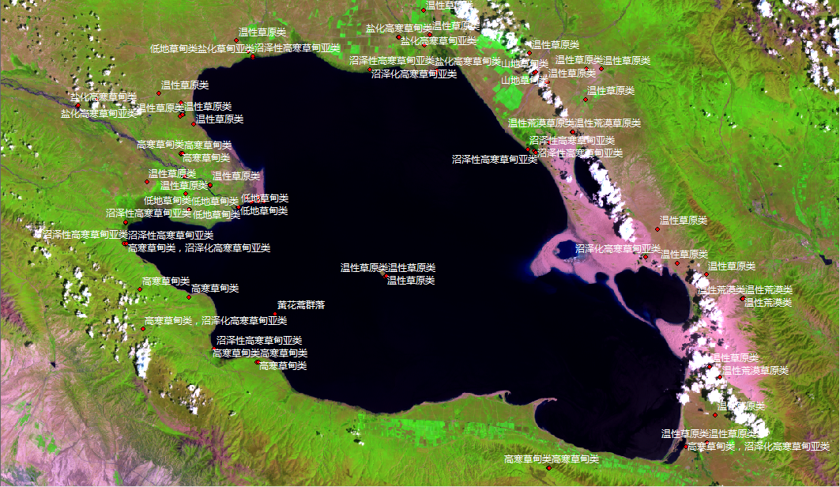
Field Investigation and survey

Slide 10
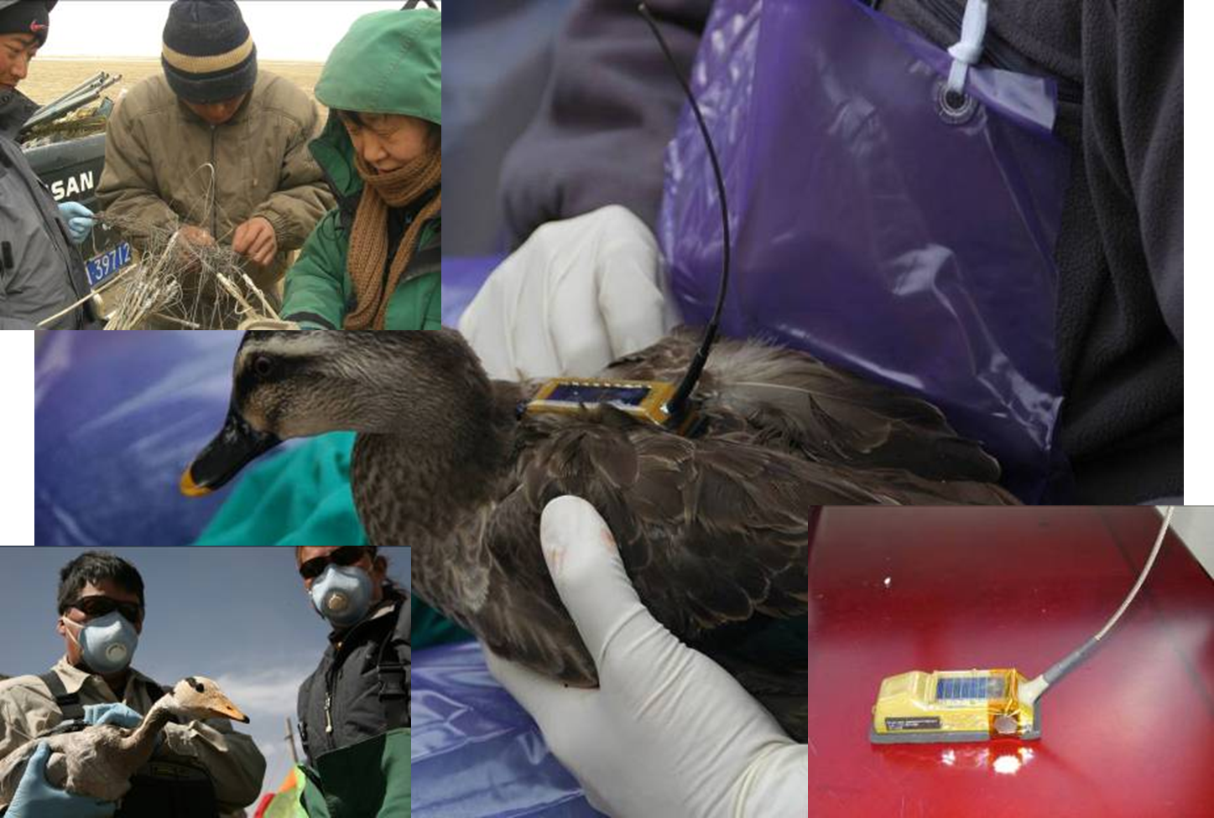
Equipment was programmed to record GPS locations every 2 hours, and the record data were uploaded to the Argos satellite tracking
system every 2 days
GPS solar-powered Platform Terminal Transmitters (PTT)

Slide 11
Remote sensing data
Wetland survey data
Bird survey data
Animal and botany species data
Bio-informatic data
Bird migration data
Hydrologic data
Monitoring Video data
Weather data
GIS data

Slide 12
Outline
Introduction
Data collection and database system
Bird Species identification
Future work

Slide 13
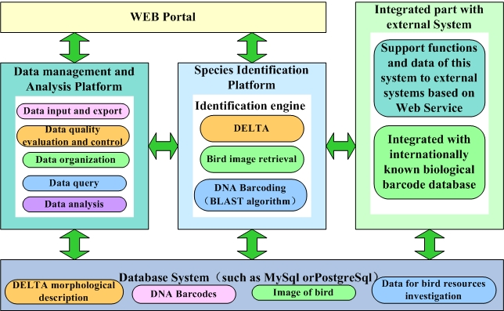
System Architecture

Slide 14
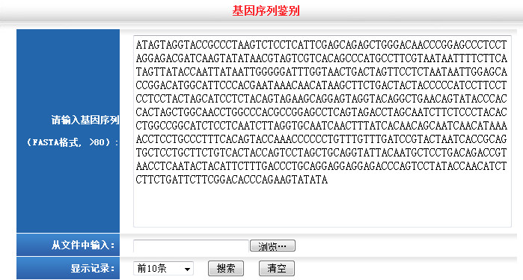
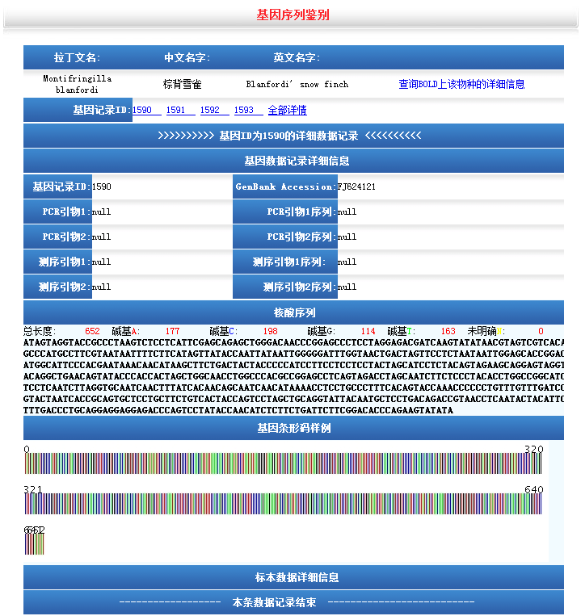
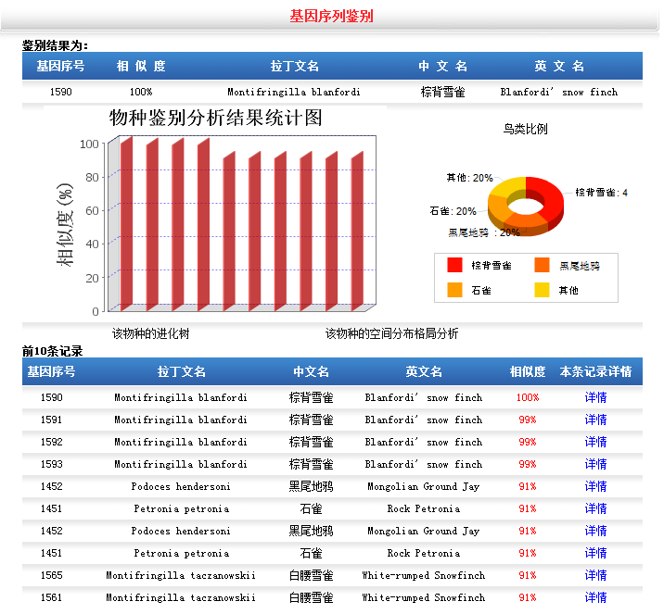
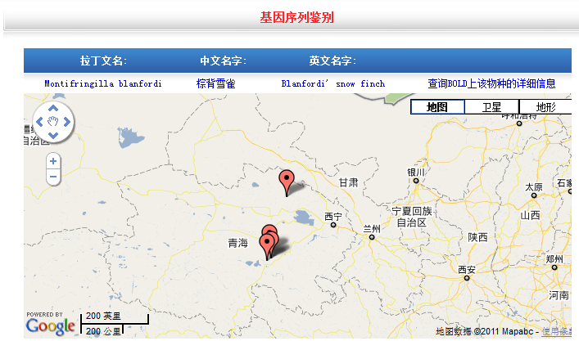
(1) DNA Barcoding
Notes:
14

Slide 15
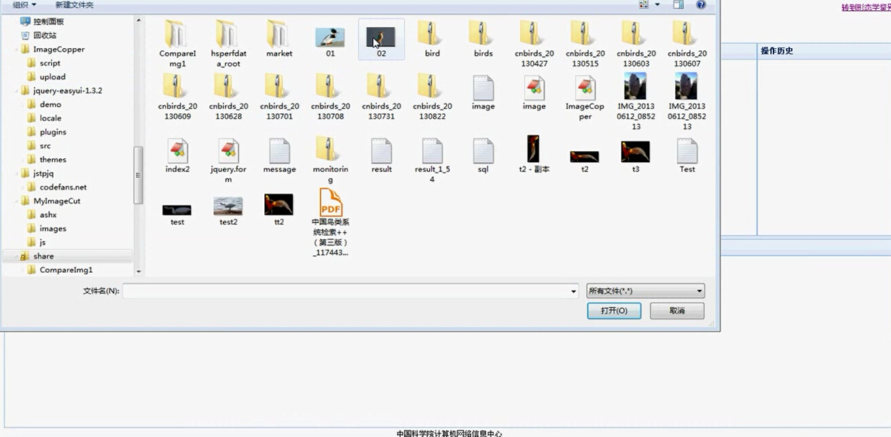
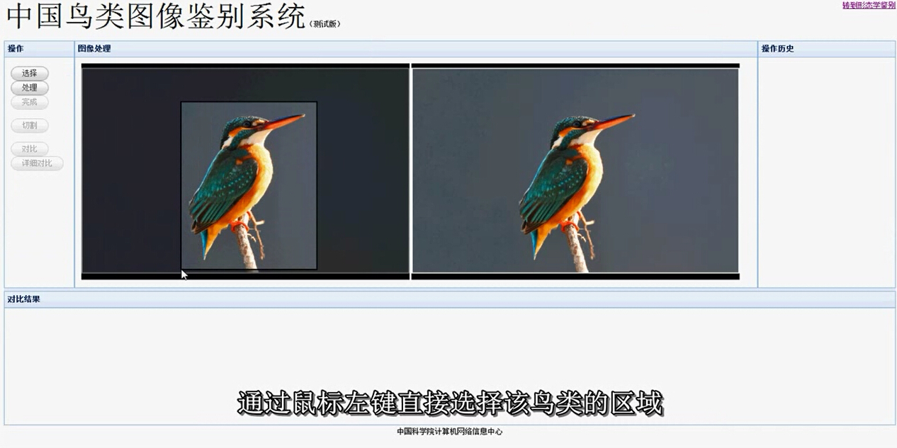
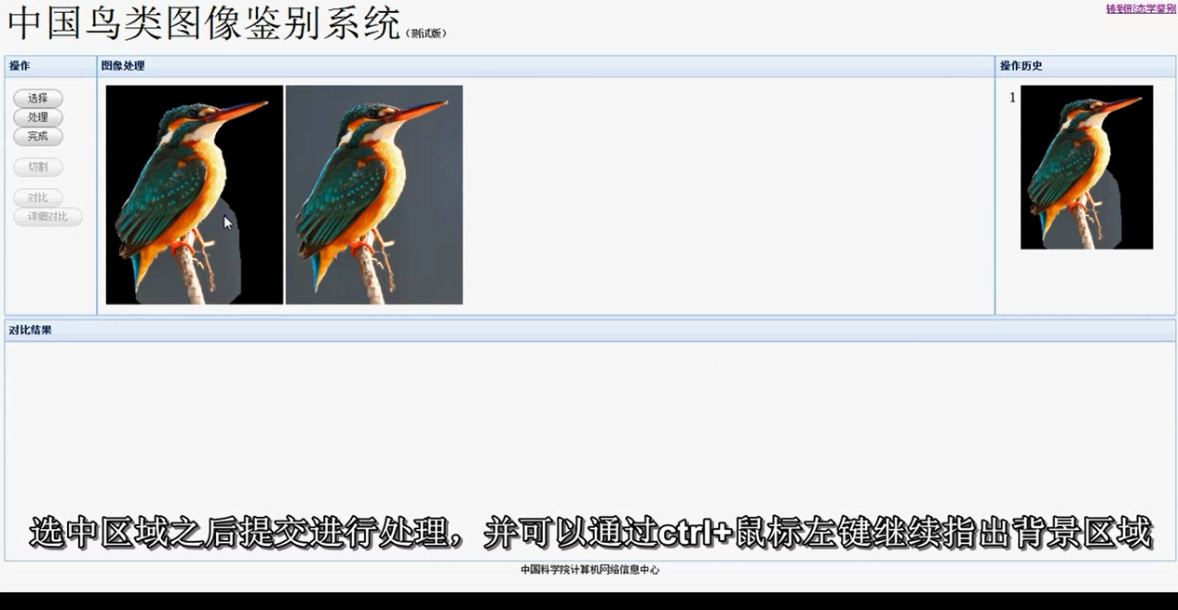
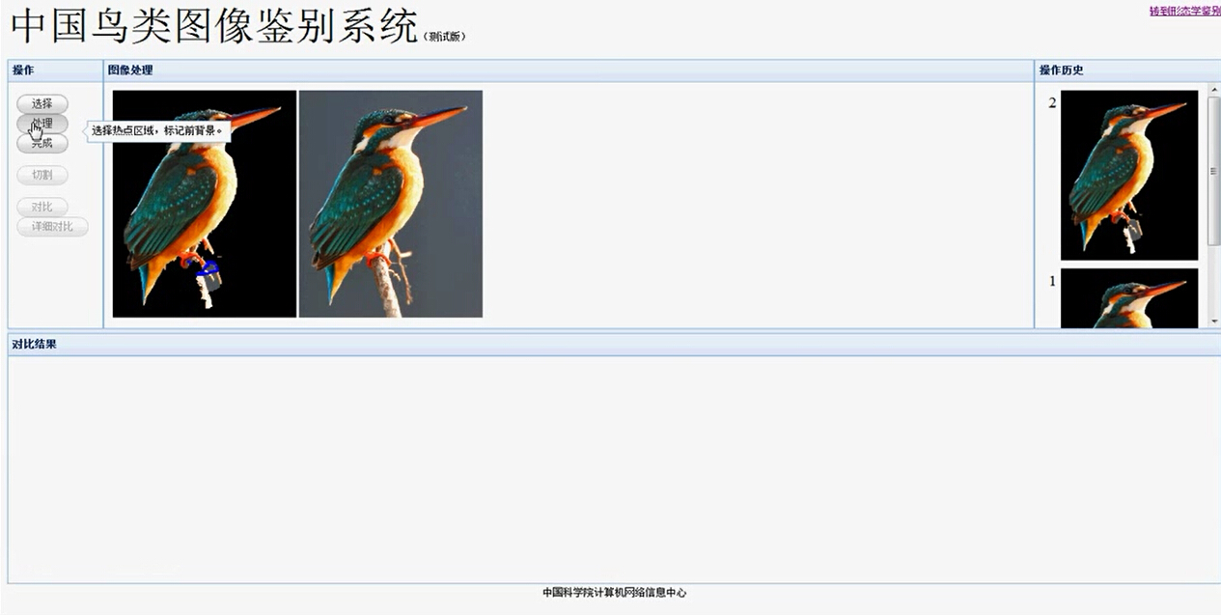
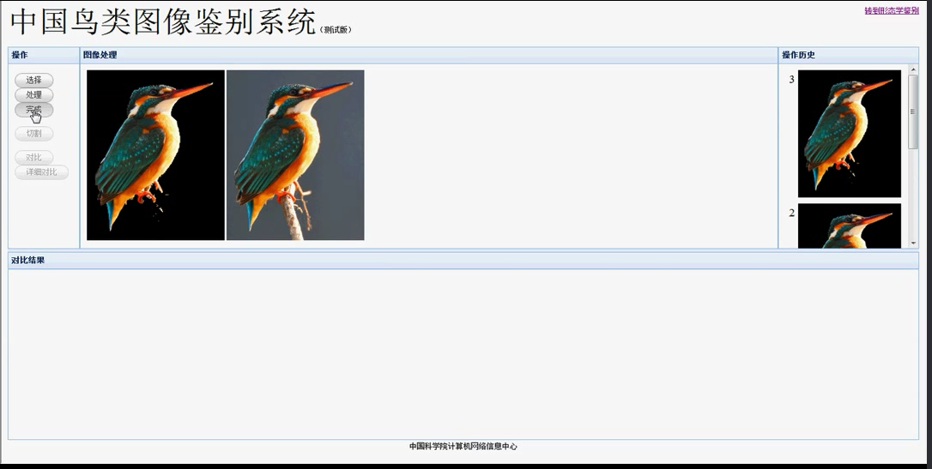
(2) Bird image retrieval

Slide 16
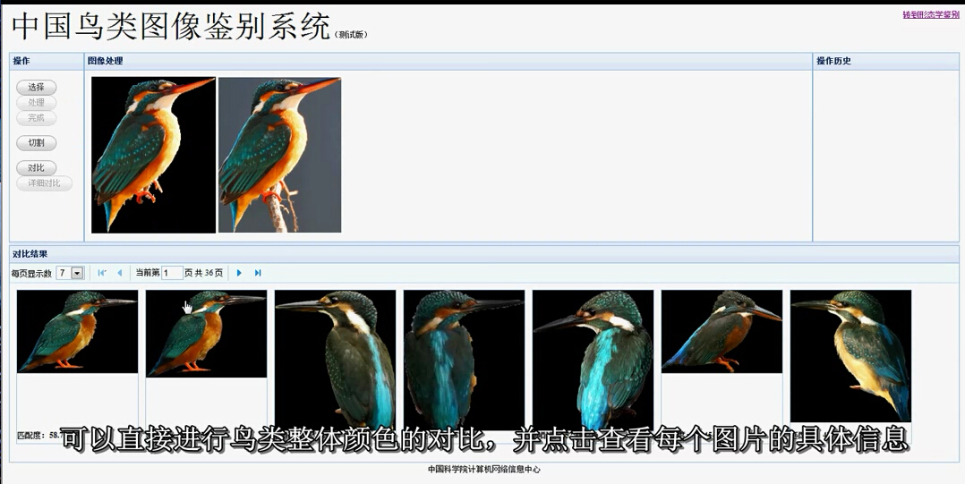
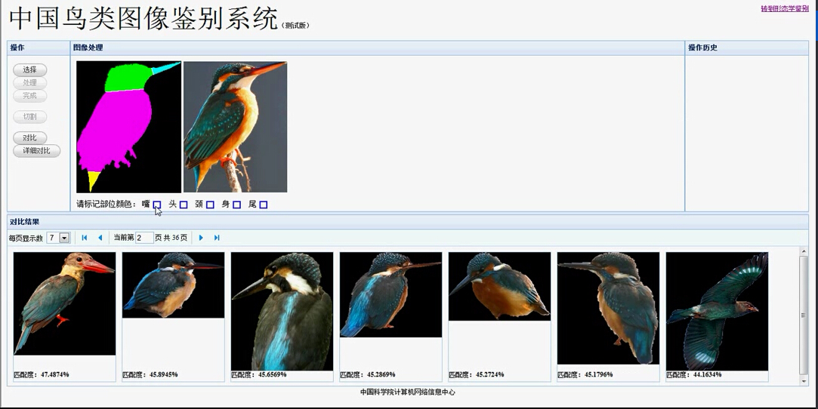

Slide 17
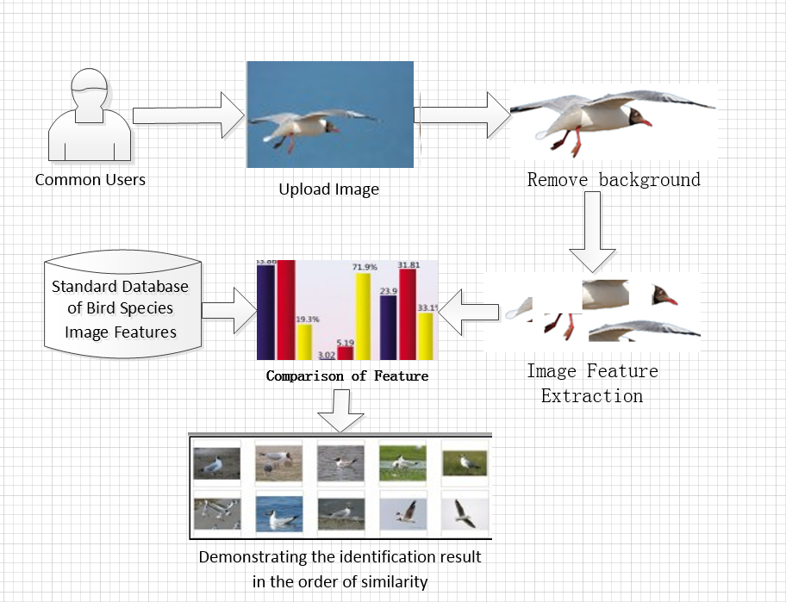

Slide 18


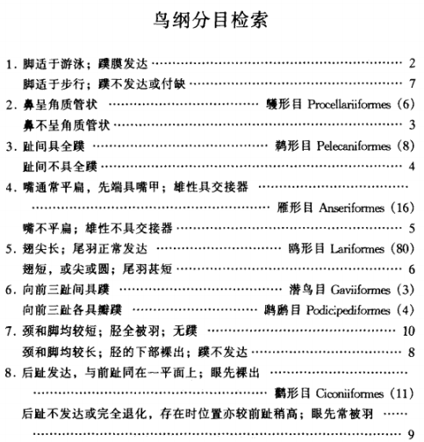
(3) Morphological Identification
Chinese birds retrieval system
Academician Zheng Zuoxin
Third version

Slide 19
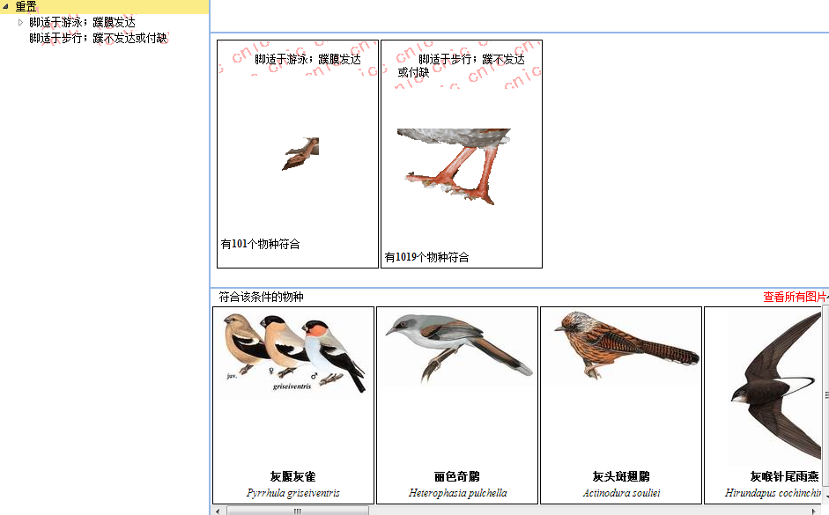

Slide 20
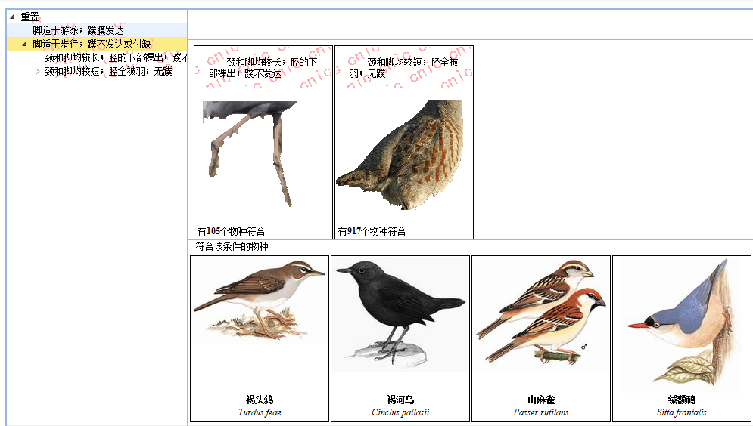

Slide 21
Outline
Introduction
Data collection and database system
Bird Species identification
Future work

Slide 22
Future Work
Data collection - more data accumulated
Improve the identification methods to achieve better accuracy and better performance
Voice recognition
More analysis and e-Science application
……

Slide 23
Thanks!
lijian@cnic.cn

